Slide 1

Seasonal Agriculture Performance Analysis
Name –Praveen Bisoi
College Name –ISBR BUSSINESS SCHOOL]
AICTE STU ID :STU6a652848ee4cb1785014344

Slide 2

PROBLEM STATEMENT
(Agricultural activities are influenced by seasonal variations in environmental conditions, farming practices, resource availability and market conditions. As a result, agricultural performance may differ from one season to another. However, raw agricultural data does not clearly explain how agricultural performance changes across seasons or what patterns can be observed in different seasonal conditions. The problem is to analyze the given agricultural dataset and investigate seasonal differences in agricultural performance by identifying meaningful patterns, trends, relationships and variations within the available data.

Slide 3
PROJECT DESCRIPTION
Analyzed agricultural data across Kharif, Rabi, and Zaid seasons.
Studied the impact of seasonal, environmental, and farming conditions on agricultural performance.
Evaluated key metrics including yield, production, revenue, profit, water usage, rainfall, and irrigation.
Performed data cleaning, exploratory data analysis, statistical analysis, correlation analysis, and visualization using Python.
Compared crop, regional, and seasonal performance to identify important patterns and variations.
Generated data-driven insights and recommendations for better seasonal planning, crop selection, resource utilization, and profitability.

Slide 4

WHO ARE THE END USERS?
Farmers – Improve crop selection, irrigation planning, and seasonal farming decisions.
Agricultural Officers – Monitor seasonal performance and support farmers with data-driven recommendations.
Government Agencies – Plan agricultural policies, subsidies, and resource allocation.
Agricultural Researchers – Study seasonal trends, crop productivity, and environmental impacts.
Agri-Business Companies – Forecast crop production and plan supply chain and market strategies.

Slide 5

Technology Used
Python – Programming and data analysis
Pandas – Data cleaning, manipulation, grouping, and aggregation
NumPy – Numerical calculations and data processing
Matplotlib – Creating charts and visualizations
Seaborn – Statistical graphs and relationship analysis
Jupyter Notebook – Developing and documenting the complete analysis
Technology Stack:
Python → Pandas → NumPy → Matplotlib → Seaborn → Jupyter Notebook

Slide 6
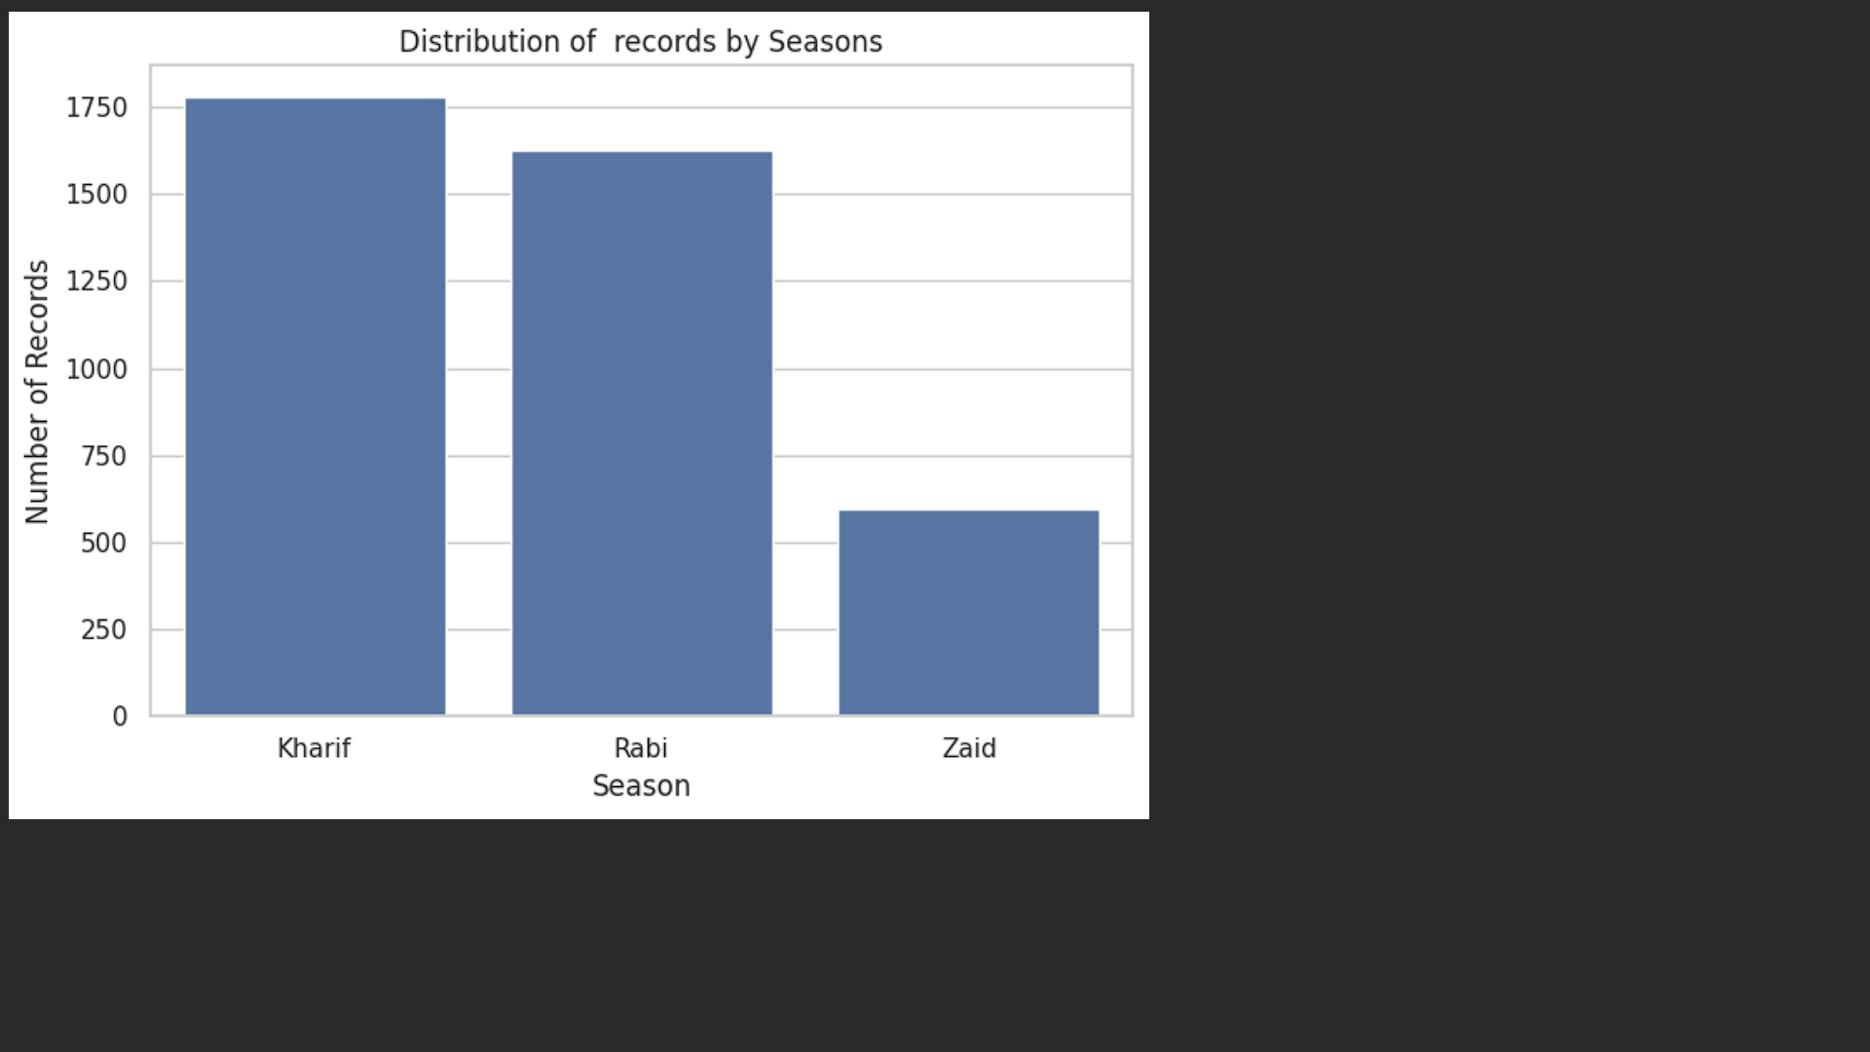
RESULTS
This bar chart shows the number of agricultural records available for each season.Kharif: ~1,775 records — highest representation.
Rabi: ~1,620 records —
second highest.Zaid: ~590
records — lowest representation.Kharif and Rabi together account for most of the observations, while Zaid has considerably fewer records.

Slide 7
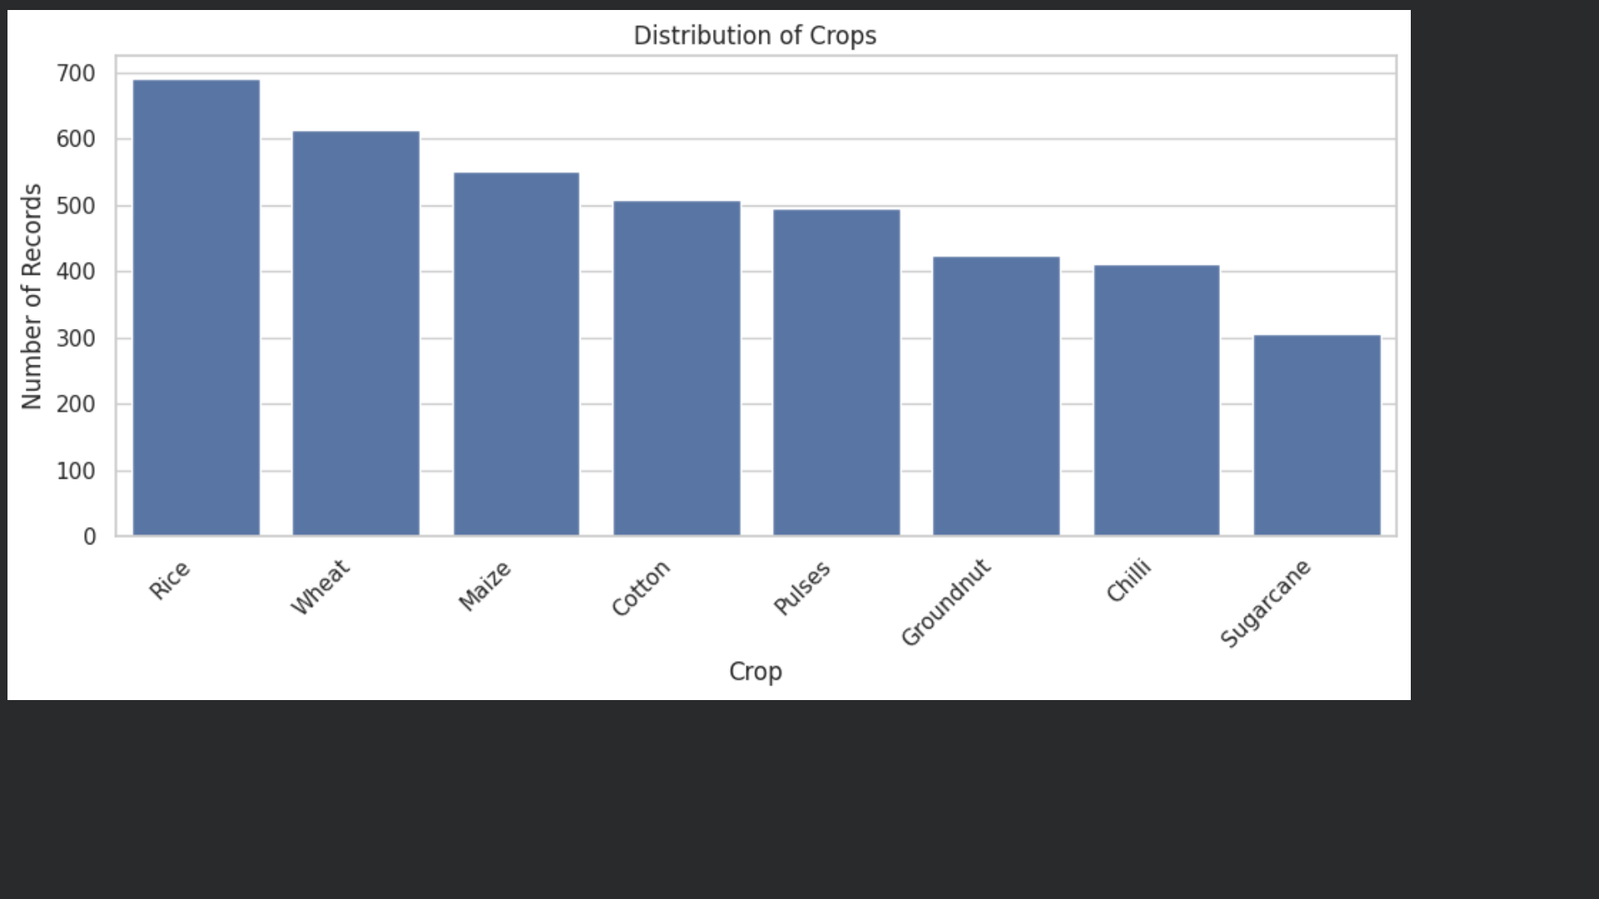
RESULTS
This bar chart shows the distribution of agricultural records across different crops
.Rice has the highest number of records, approximately 690
.Wheat is the second most represented crop, with around 610 records
.Maize has approximately 550 records.Cotton and Pulses have around 500 records each
.Groundnut and Chilli have fewer records, around 420 and 410 respectively.
Sugarcane has the lowest representation, with around 300 records.

Slide 8
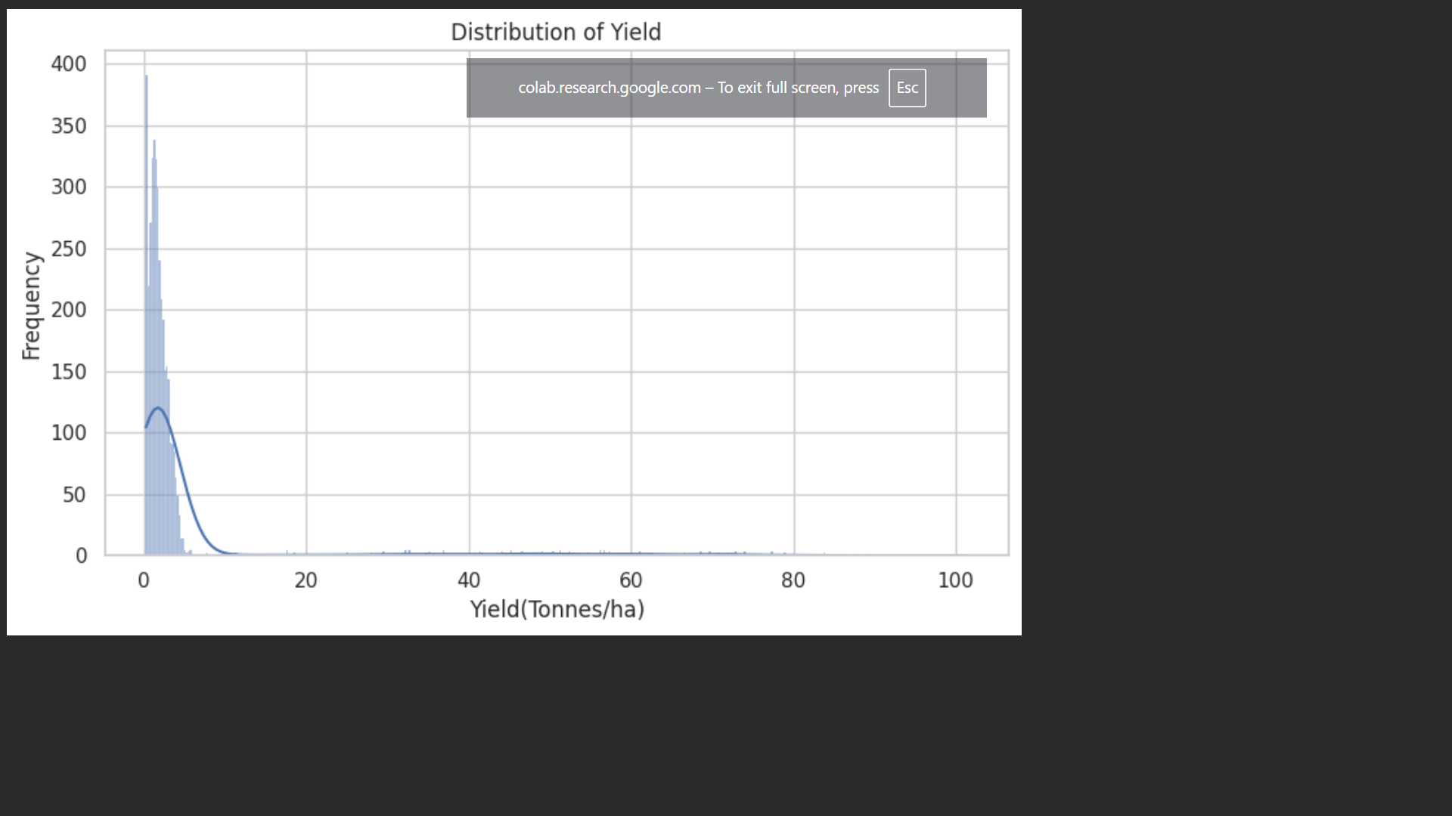
RESULTS
This is a histogram showing the distribution of agricultural yield, measured in tonnes per hectare (Tonnes/ha).Most farms have a yield concentrated around 0–5 tonnes/ha.The highest frequency occurs at the lower yield values, meaning most observations have relatively low yields.The distribution is strongly right-skewed because a small number of observations have very high yields.There are some extreme values extending to very high yields (above 20 and even up to around 100 tonnes/ha).These extreme observations may represent high-performing farms, different crop characteristics, or potential outliers and should be investigated before drawing conclusions.

Slide 9
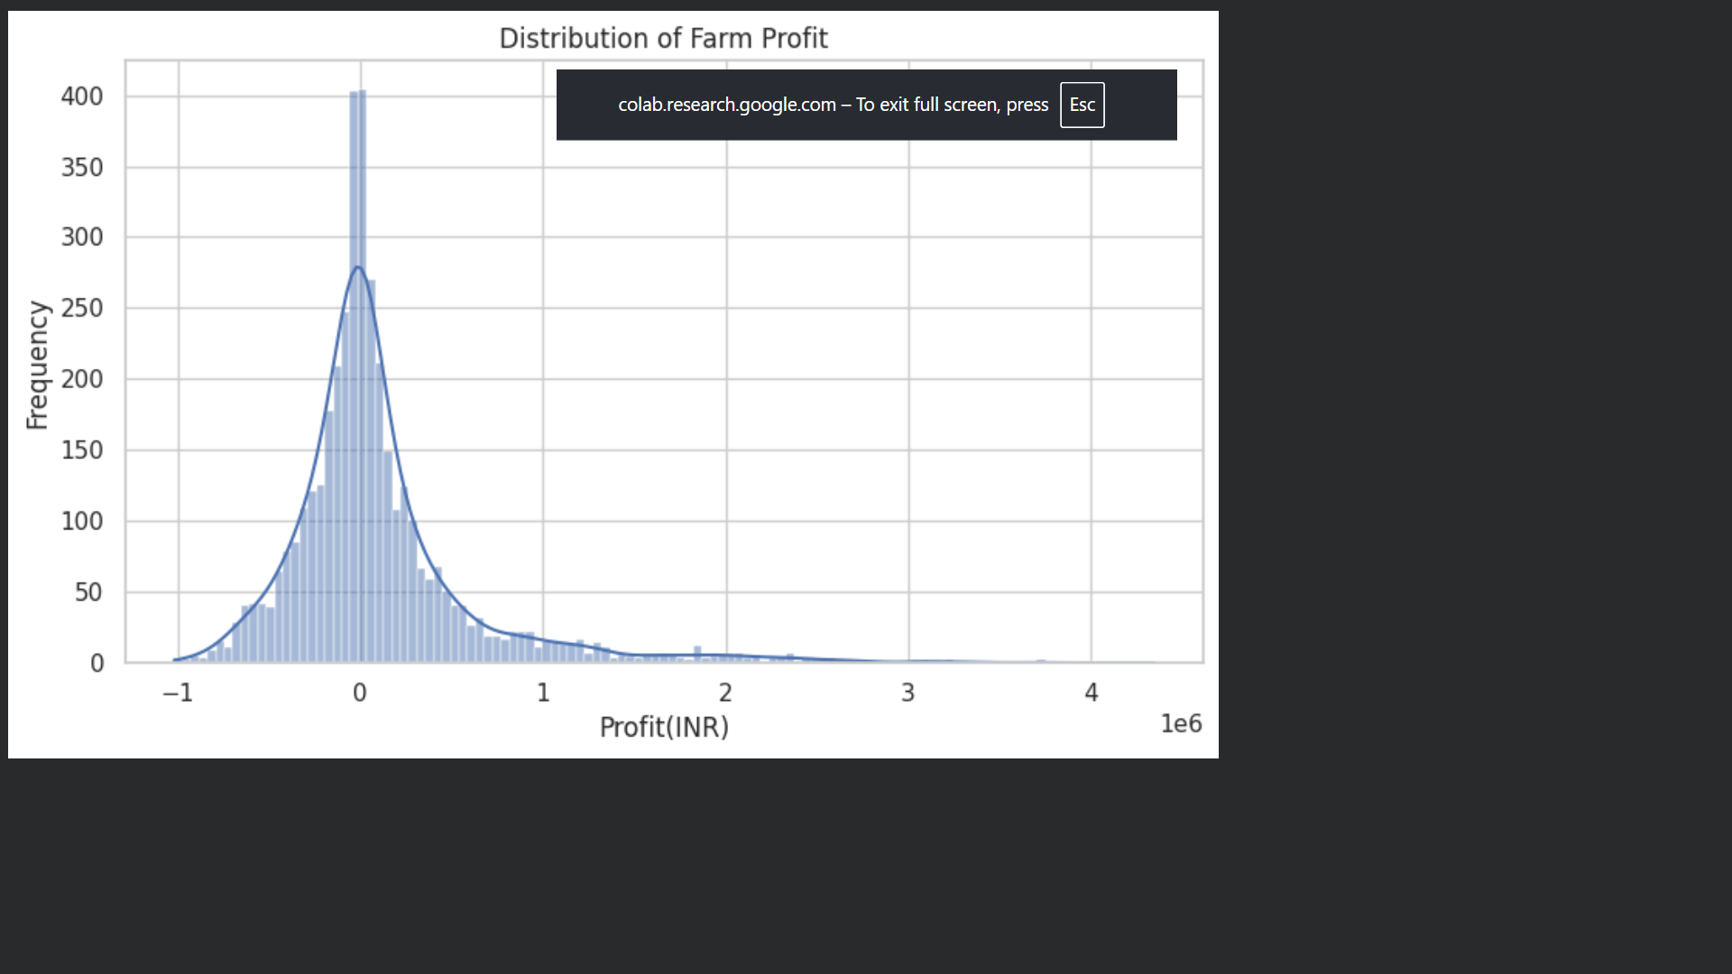
RESULTS
[Add screen shots of your code ]
This is a histogram showing the distribution of farm profit, measured in INR (₹).
Most farm profits are concentrated around ₹0 to ₹2–3 lakh.
The graph includes both negative and positive profits, meaning some farms experienced losses while others made profits.
The distribution is right-skewed because a small number of farms have very high profits, extending to ₹40 lakh+.
There are also some farms with significant losses, shown on the negative side of the graph.
The large spread indicates that farm profitability varies considerably between farms.

Slide 10
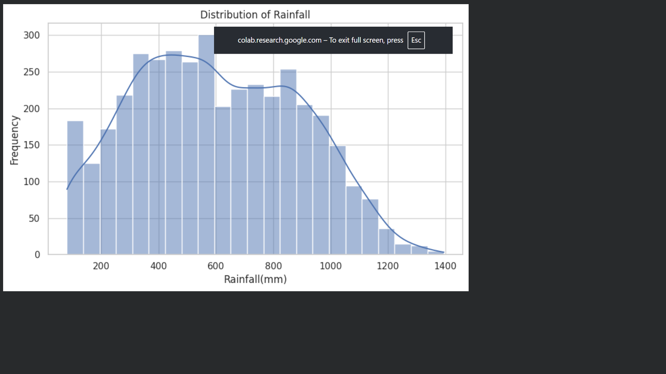
RESULTS
[Add screen shots of your code ]
This is a histogram showing the distribution of rainfall across the farms, measured in millimetres (mm).
Rainfall values range approximately from 100 mm to 1,400 mm.
Most observations are concentrated between 300 mm and 1,000 mm.
The highest frequency is around 500–600 mm, meaning this rainfall range occurs most often in the dataset.
Very high rainfall values, above 1,100–1,200 mm, occur less frequently.
Very low rainfall around 100–200 mm is also less common compared with the middle range.

Slide 11
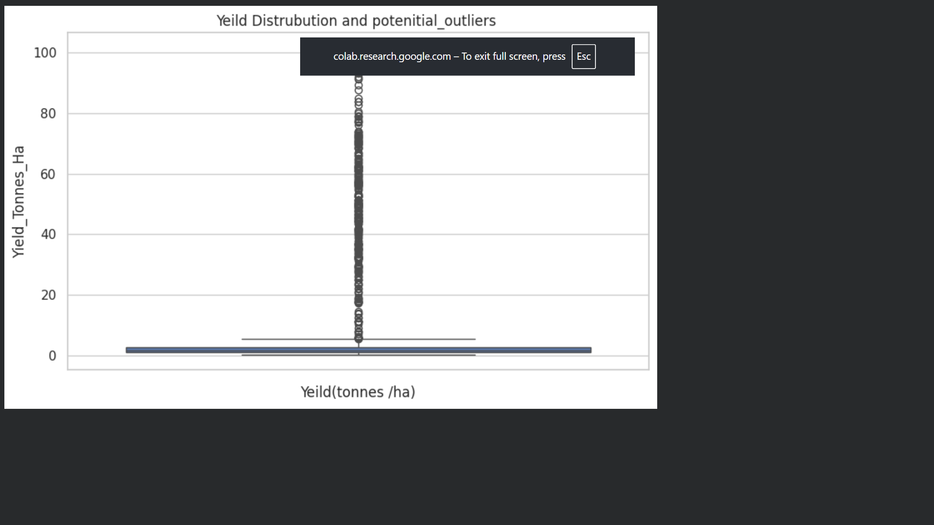
This is a box plot showing the distribution of crop yield (Tonnes/ha) and potential outliers.The box is concentrated near the lower yield range, showing that most farms have relatively low and similar yield values.The whisker extends to around 5 tonnes/ha, representing the typical range of yield values.There are many points above the upper whisker, which are identified as potential outliers.Some extreme observations reach 80–100 tonnes/ha, which is much higher than the majority of the data.This indicates that the yield distribution has very high variability and extreme values.These outliers should not automatically be removed; they may represent unusually high-performing crops/farms or unusual observations that need further investigation.

Slide 12
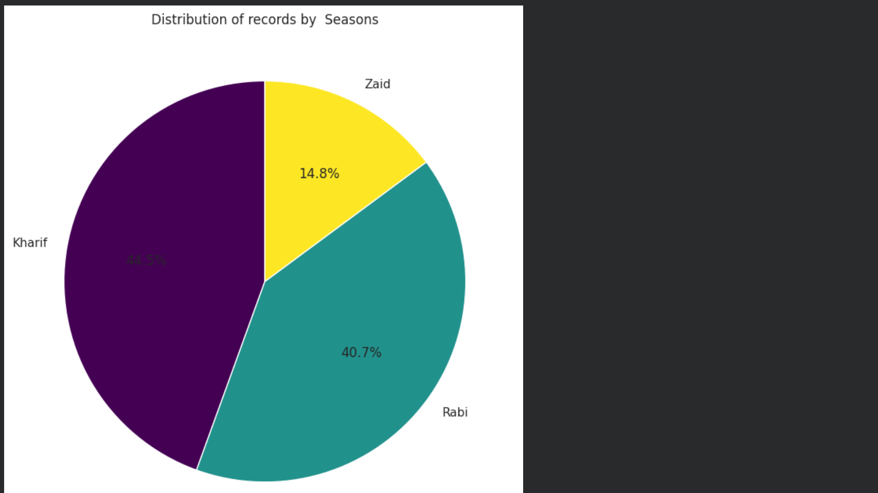
This is a pie chart showing the percentage distribution of agricultural records across the three seasons.
🌾 Kharif – 44.5% → Has the largest share of records.
🌱 Rabi – 40.7% → Has the second-largest share and is close to Kharif.
☀️ Zaid – 14.8% → Has the smallest share of records.

Slide 13
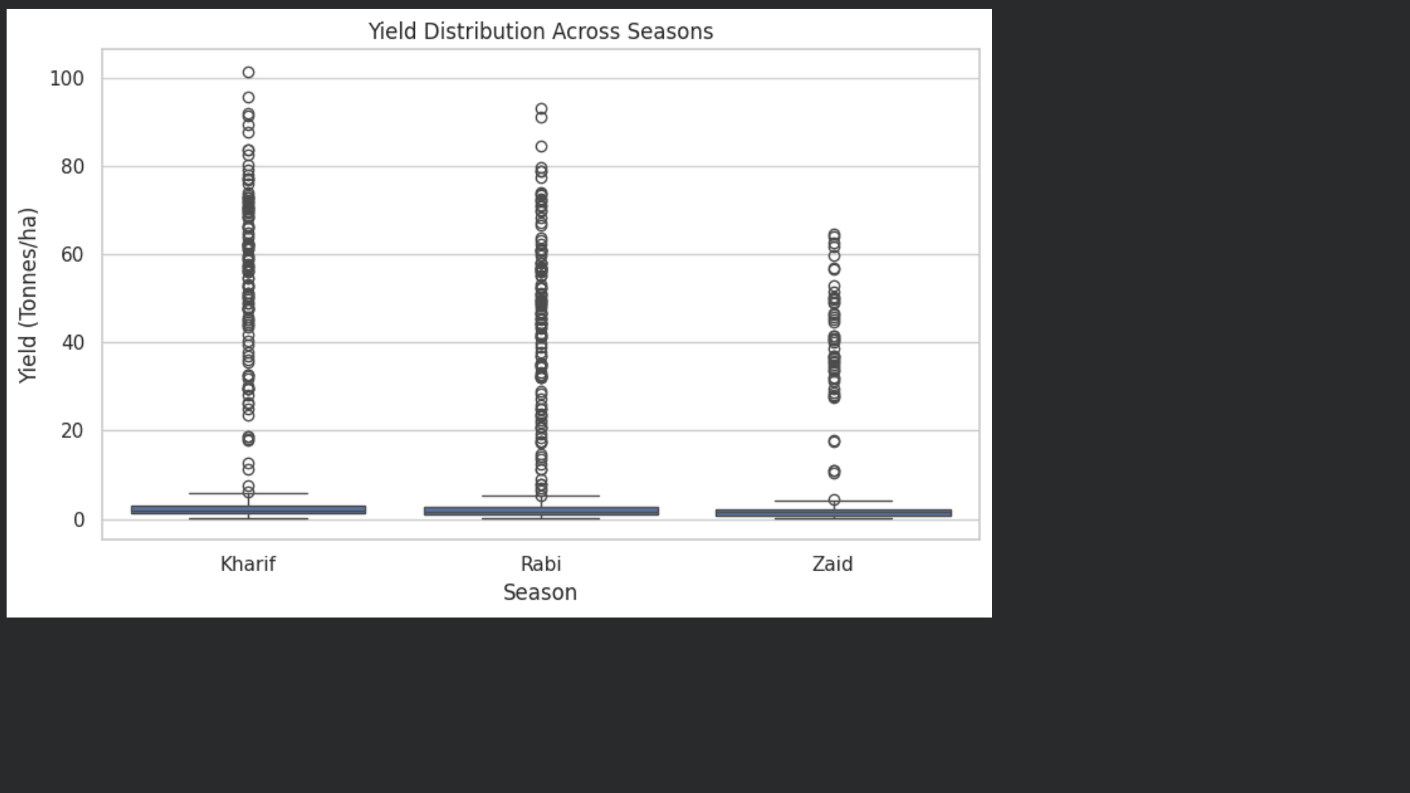
This is a box plot comparing crop yield across Kharif, Rabi, and Zaid seasons, measured in tonnes per hectare (Tonnes/ha).Kharif: Shows the widest spread of extreme values, with some observations reaching above 100 tonnes/ha.Rabi: Also has many high-yield outliers, reaching around 90+ tonnes/ha.Zaid: Has fewer extreme values, with the highest observations reaching around 65 tonnes/ha.The main boxes for all three seasons are concentrated at low yield levels, meaning most observations have relatively low yields.The large number of points above the whiskers indicates many potential outliers/high-yield observations.Kharif appears to have the highest extreme yield values, while Zaid has a lower maximum among the three.

Slide 14
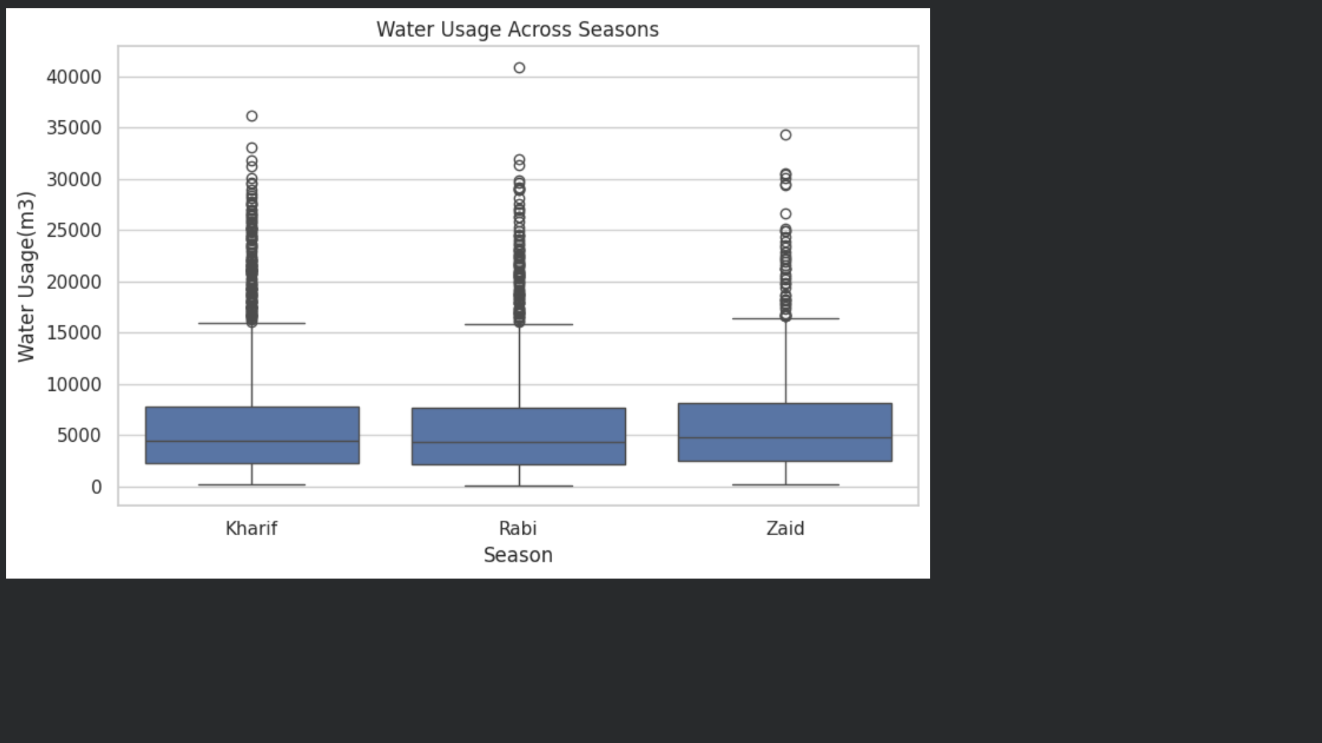
This is a box plot showing water usage across Kharif, Rabi, and Zaid seasons, measured in m³ (cubic metres).
Kharif: The median water usage is around 4,500 m³.
Rabi: The median is also around 4,500 m³, so its typical water usage is quite similar to Kharif.
Zaid: Has a slightly higher median water usage, around 4,800–5,000 m³.
The boxes show that water usage has considerable variation within each season.
All three seasons contain many high-value outliers, with some farms using more than 15,000 m³.
Rabi has the highest extreme value, reaching approximately 41,000 m³.
Overall, typical water usage is fairly similar across the three seasons, but some farms consume much larger amounts of water.

Slide 15
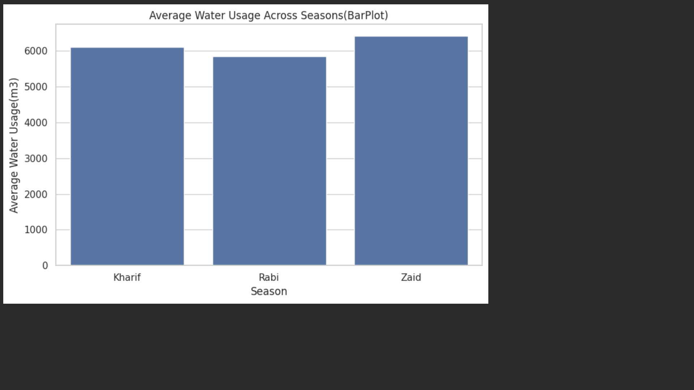
This bar chart shows the average water usage across Kharif, Rabi, and Zaid seasons, measured in cubic metres (m³).Zaid has the highest average water usage, around 6,400 m³.Kharif uses slightly less, around 6,100 m³.Rabi has the lowest average water usage, around 5,800 m³.The difference between the seasons is relatively small compared with the overall water consumption.

Slide 16
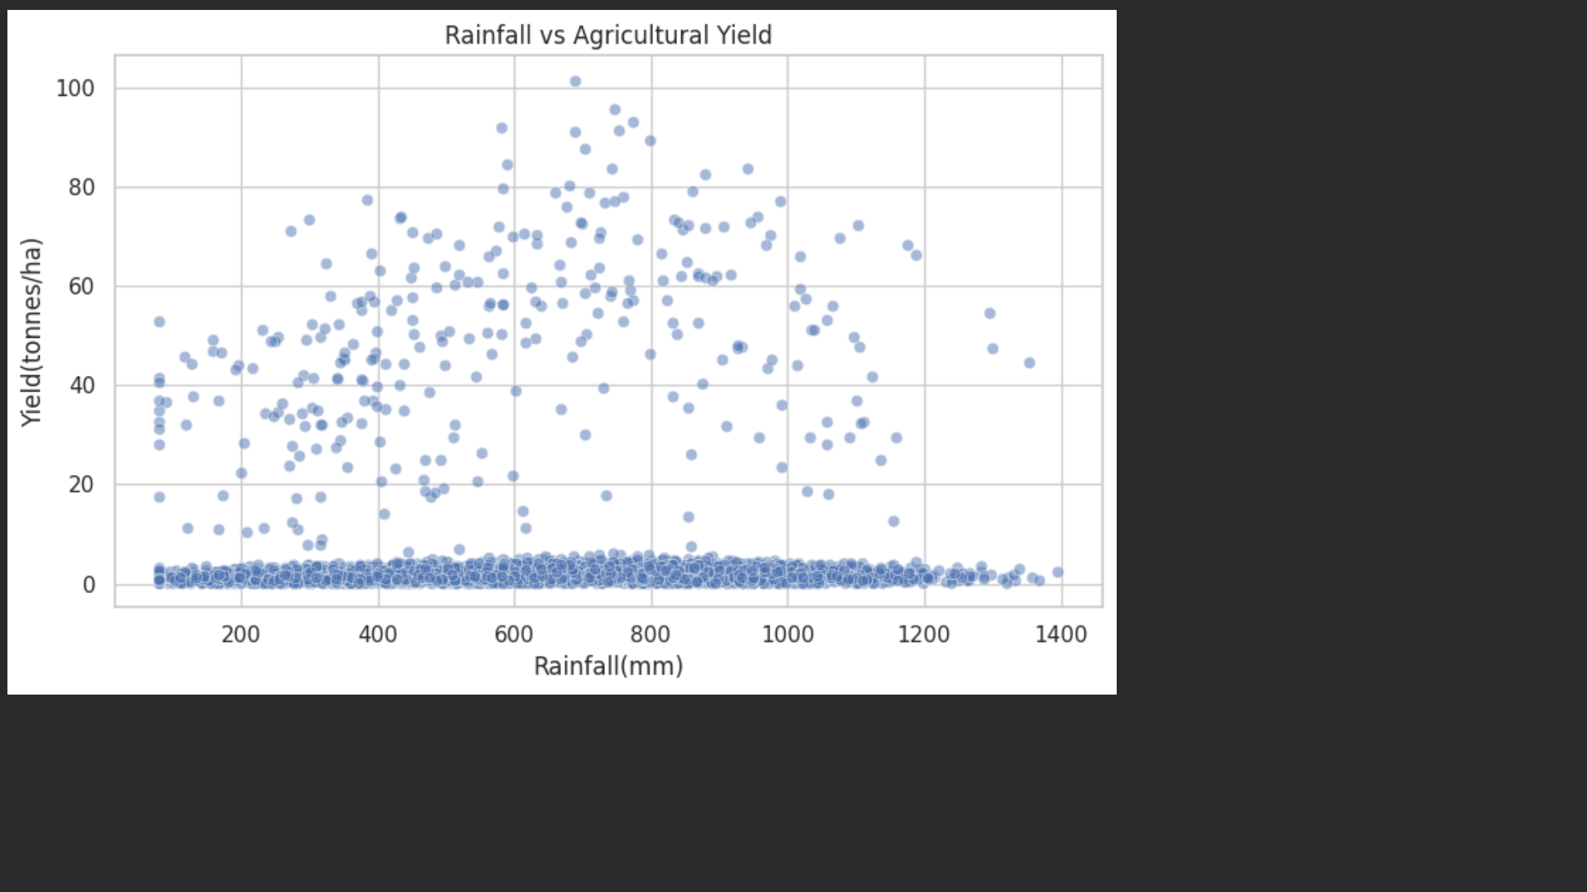
This is a scatter plot showing the relationship between Rainfall (mm) and Agricultural Yield (tonnes/ha).
X-axis: Rainfall in millimetres (mm)
Y-axis: Agricultural yield in tonnes/ha
Most observations are concentrated at low yield values (0–5 tonnes/ha).
There are also several observations with much higher yields, reaching 100+ tonnes/ha.
The high-yield points are spread across different rainfall levels, especially between approximately 300–1,000 mm.
This means that rainfall alone does not completely explain agricultural yield.
Other factors such as crop type, irrigation, soil conditions, farming practices, temperature, and other environmental factors may also influence yield.

Slide 17
Future scope
1.Predictive Analysis – Predict future crop yield, production, and profitability using Machine Learning.
2.Weather Integration – Include real-time weather data such as rainfall, temperature, and humidity for better seasonal predictions.
3.Crop Recommendation System – Recommend suitable crops based on season, soil, weather, and expected profitability.
4.Smart Irrigation – Develop a system to recommend optimal water usage and irrigation methods.
5.Regional Forecasting– Predict agricultural performance for different states or regions.
6.Real-Time Dashboard – Develop an interactive **Power BI/Tableau dashboard** for continuous monitoring.
7.AI-Based Decision Support – Build an AI system that provides personalized recommendations to farmers and agricultural officers.

Slide 18
GitHub Link
https://github.com/praveenbisoi209/Seasonal-Agriculture-Performance-Analysis

Slide 19

VOIS Course completion certificate -
Course name- Data Visualization

Slide 20

Thank you
.
.

